Slide 1
Item 611 Update
Performance Based Specification
Hans Gucker, P.E.

Slide 2
611 Spec Update
Recent Spec Changes – January 2015
Require geotextile fabric over coarse aggregate backfill
Final Backfill shall meet requirements of Item 203

Slide 3
611 Review
Contractor selects conduit material
Works with conduit manufacturer to develop installation plan
Installs pipe & provides installation documentation
Provides performance evaluation
Inspections
Testing
Findings reviewed by 3rd party engineer

Slide 4
611 Project Submittals
Shop Drawings (as required)
Installation Plan
Construction Inspection Forms
Performance Report
Critical elements of the performance spec

Slide 5
Shop Drawings
Two cases where shop drawings get forwarded on
Load rating calculations (structures under ODOT road)
Send to District P&E Eng. forward to OSE
Change in structure type – verify hydraulic design
Send to District Hyd. Eng. forward to OHE
Signed by registered engineer (language revised in 800 – One Engineer only)
Department has 15 days for the review

Slide 6
Installation Plans
Needs to be specific… general
8 items required – for each run
Manufacturer must sign off on installation plan
Revised installation method or material requires a revised plan (signed by manufacturer)

Slide 7
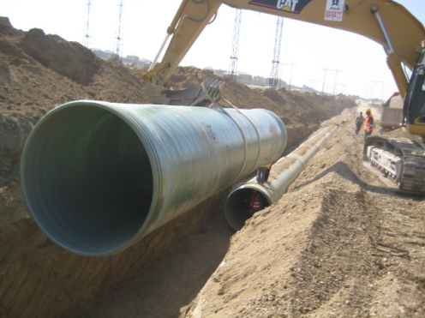
Installation Plans
Field Observations
Small culvert projects still problematic
Incomplete – not all runs or structures
Slow & Unorganized
Backfill material or compaction changing during construction
Manufacturers not reviewing plan

Slide 8
Installations Plans
Backfill material
All backfill & bedding material required to be identified – with compaction
Structural and Final backfill now defined
Final Backfill
CMS Item 203
Final Backfill
Structural Backfill
Manufacturers only review for structural component of conduit
Conduit/Culvert
Bedding

Slide 9
Installations
Coarse aggregate backfill
Still requires geotextile below groundwater
Geotextile fabric over course aggregate
Fine Graded
Geotextile fabric
Course Aggregate #57’s
Conduit/Culvert
Bedding
Geotextile fabric

Slide 10
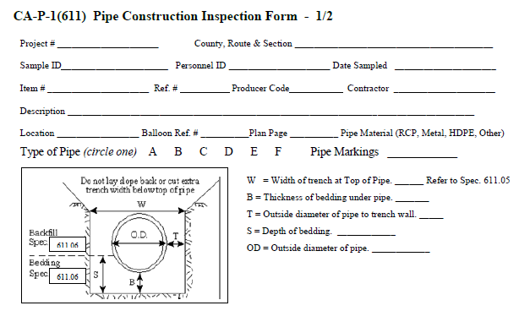
Construction Inspections
Performed by Contractor
Documents compliance with installation plan – Quality Control
Modified installation - require modified installation plan
Density testing included

Slide 11
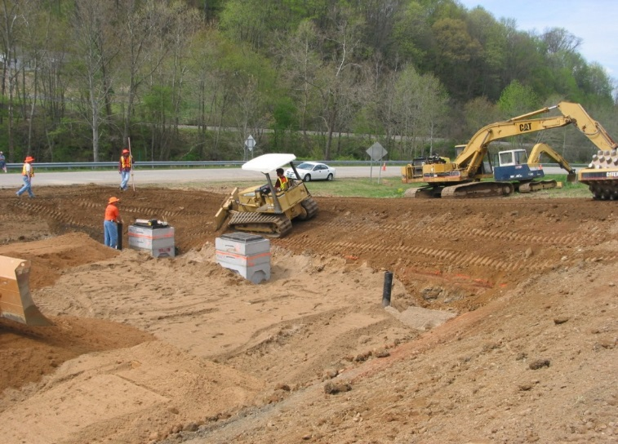
Construction Inspections
Field Observations
Poor quality or minimal inspections – untrained personnel
Rubber stamped inspection forms
Transfer of inspection forms has been typically slow or not occurring
Modifying installation - without informing Engineer

Slide 12
Performance Reports
Performance Inspection
Evaluation
Performance Report
Recommendations
Final submittal – documents performance
Includes Performance Inspection
Independent Engineer evaluation
Location data Types A & B
District should not accept work if all information is not present
Evaluation needs to identify all deficiencies

Slide 13
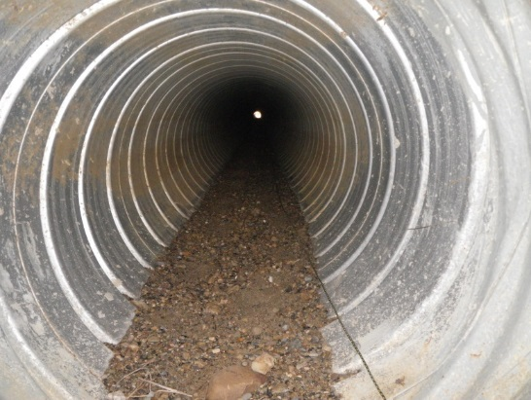
Performance Inspection
Only (Type A, B & C) conduits and structures
Performed 30-90 day after installation period – based on each conduit phase
Begins after rough subgrade compaction
Manual or remote – both require video
Independent Engineer evaluates findings
30 day waiting period may be waived
Very few instances when waiver applies
No access to conduit
Inspection needs to be planned into work

Slide 14
Performance Inspection
Field Observations
Only parts of a conduit inspected
All joints…not only some
Manual inspection not videoed
Surface settlements not observed
Mandrels not meeting size requirements
Based on nominal pipe size reference SS902

Slide 15
Inspection Videos
Field Observations
Remote inspections require crawler mounted camera per SS902
Ability to measure cracks and joint gaps
Consider how files are presented to project
Organize so run can be identified by file name
File size
Ensure material can be retrieved
CD’s with paper cover can become unreadable
Project Examples…
O:\Construction\Gucker\D1 Construction School\31-D6-D7.mpg
O:\Construction\Gucker\D1 Construction School\vertical sag 130558_CB 3A-CB 3A_10282014.wmv

Slide 16
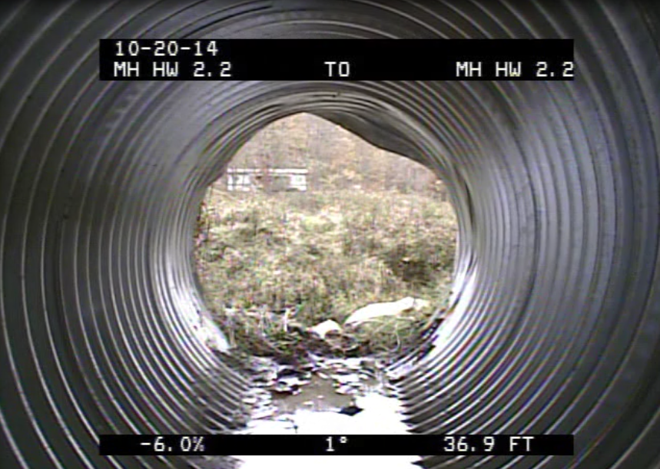
Engineer Evaluations
No noted deficiency in evaluation

Slide 17
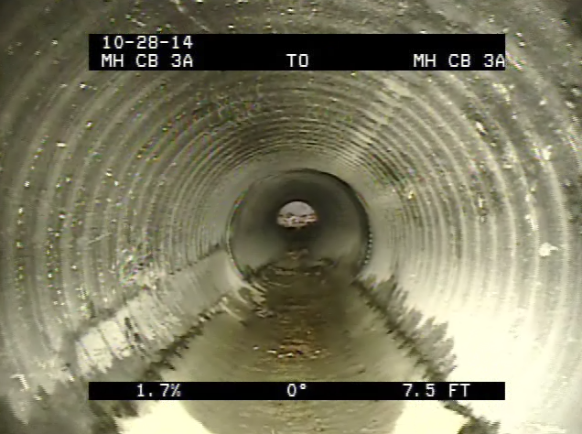
Engineer Evaluations
Vertical sag not noted in evaluation

Slide 18
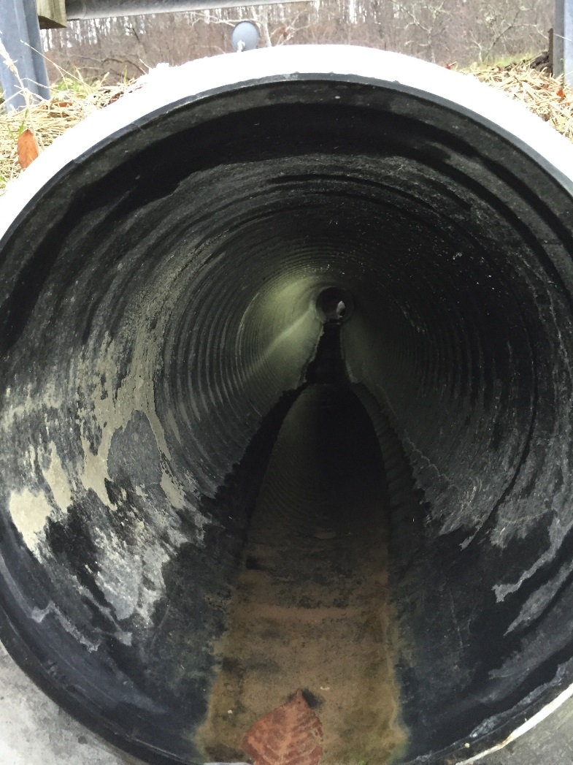
Engineer Evaluations
Horizontal deflection at beginning of pipe – not noted

Slide 19
Racking vs. Deflection

Slide 20
Questions/Disscussion?

